Slide 1
STALLION – An Overview
An RFID Overview
Asset Management Process
Proposed RFID Solutions
Benefits of Stallion RFID Solution
ASSET MANAGEMENT
Prepared by Stallion systems & solutions Pvt Ltd
Private and Confidential

Slide 2

About Us
We introduce ourselves as pioneer in AIDC (Auto Identification and Data Collection) with respect to Barcode, RFID (Radio Frequency Identification), EAS (Electronic Article Surveillances) and Utility Software solutions.
There are many reasons for you to be rest assured, if it is STALLION.
STALLION Philosophy is deep rooted among all its team members with CUSTOMER FIRST attitude.
21 years of expertise, pan India and global presence make it unbeatable against competition.
  One of the Leading companies in India to give entire RFID Solutions.
15000 best of the best leading industry segment customers are our strength and they vouch for STALLION. 300+ employees with less attrition rate speak volume about the organization and assure continuity in our services Strong financial background and Quality products from top line manufacturers across the world give longest life term for products and solutions, even though it is slightly costlier.
Private and Confidential

Slide 3
RFID (an overview)
Radio Frequency IDentification describes the use of radio frequency signals to provide automatic identification of items.
RFID is a flexible technology that is convenient, easy to use, and well-suited for automatic operation. It combines advantages not available with other identification technologies.
RFID does not require contact or line-of-sight to operate, can function under a variety of environmental conditions, and provides a high level of data integrity. In addition, because the technology is difficult to counterfeit, RFID provides a high level of security.
Private and Confidential

Slide 4
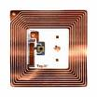
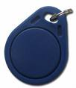
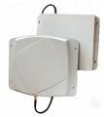
RFID (the components)
Any RFID system consists of Four main components.
  Transponder / Tag
  An RFID tag is a microchip combined with an antenna and can be attached to any object to be tracked. The tag's antenna picks up signals from an RFID reader/scanner and then returns the signal, usually with some additional data (like a unique serial number or other customized information).
  Antenna
  The antenna transmits and receives the signals to and from the tag. The quantity and type of antennas used depend on the application.
Private and Confidential

Slide 5
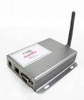

RFID (the components)
Any RFID system consists of Four main components.
  Reader & Transceiver
  The reader directs the RF transceiver to transmit RF signals, receives the encoded signal from the tag through the RF transceiver, decodes the tag’s identification and transmits the identification with any other data from the tag to the host computer. The user can change or customize the reader’s operations to suit a specific requirement by issuing commands through the host computer or a local terminal.
  Middleware
  This is the software that is customized based on the application of an RFID solution to integrate information for further use and analysis
Private and Confidential

Slide 6
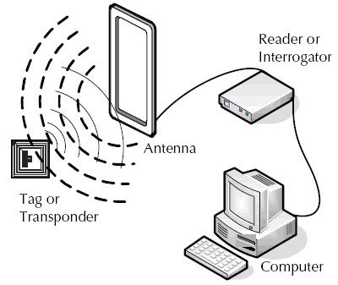
A Typical RFID System - Schematic
The tag is activated when it passes through a radio frequency field, which has been generated by an antenna and reader.
The tag sends out a programmed response.
The antenna that generated the field originally and is attached to the reader detects that response.
The transceiver (or reader) sends the data to the middleware (the RF component that interprets the data).
The middleware sends the information contained in the tags to the systems that need information.
Private and Confidential

Slide 7
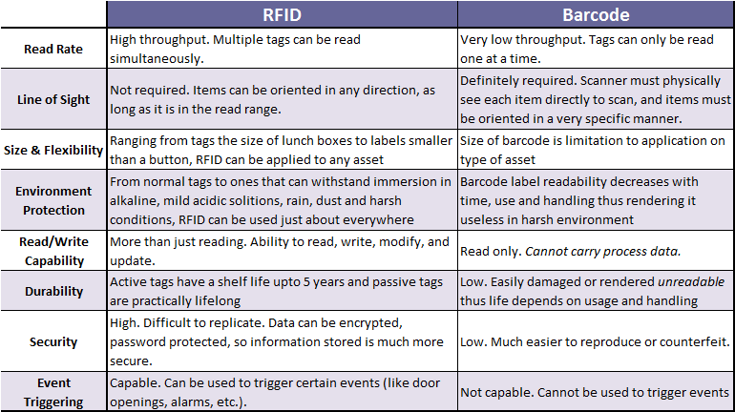
Barcodes Vs RFID
Private and Confidential

Slide 8
Asset Tracking – The common pitfalls
Assets to be tracked normally range from as small as a confidential
File Folder to as big as a Centralized Air Conditioner or a Blower.
Keeping track of these tangible assets involves labor intensive manual
work which has inherent flaws, some of the major ones are:
  Manual methods are labor-intensive and subject to error. And with highly valued, highly compensated employees, introducing intrusive methods of asset tracking only serve to reduce productivity and slow the organization’s workflow.
  Prone to mis-identification and duplication of the assets.
  Extremely time consuming.
  No proper visibility to the management on the number and type of assets
  Poor control over the movements of the critical mobile assets.
  Poor Asset management can threaten the accuracy or critical financial reports resulting in re-reporting and negatively impacting the bottom line.
Private and Confidential

Slide 9
Objective
Record Asset Movement
Ensure Data Accuracy & Reliability
Real time and Online data availability
Ability to interface with third party systems
Extensibility to support future automation
Ease of Use
… and above all
Provide complete Asset Visibility to Management at any point of time !
Private and Confidential

Slide 10
The Business Case – Asset Tracking
RFID is a flexible technology that is convenient, easy to use, and well-suited for automatic operation. It combines advantages not available with other identification technologies like Bar codes.
The system, designed to track asset movements, provides granular and accurate data records that can be used to execute more informed decisions
The value behind the system lies in its ability to automatically collect information of any asset.
This information is recorded through an application that provides records/reports within an organization with the ability to interface with other existing enterprise software.
Private and Confidential

Slide 11


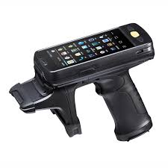
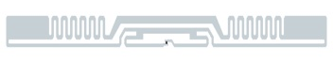
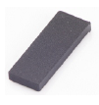

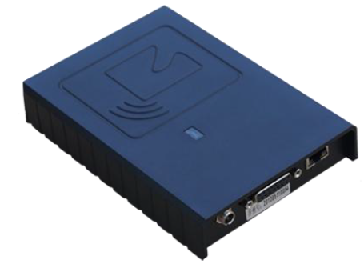
Our Distinctive Approach
ROBUST HARDWARE
MY-ASSET SOFTWARE
ENTERPRISE INTEGRATION
…we can integrate with any ERP system.
STA My-Asset Tracking System enables efficient management of fixed or movable assets and also helps in maintaining the complete history of assets with automated processes.
Software interface to Enterprise system to provide Right Information at the Right Time
Master Data Management
STA My-Asset Systems is a user-friendly, commanding tool which intensifies businesses with large range of features. It is extremely compatible with different types of readers and tags and can generate a wide combination of reports.
EPCglobal Compliant
High IP Rating
Performance Reliability
Service and Support
While it enables seamless asset management at the operational level, the advanced reporting capabilities of STA My-Asset Systems enables the strategic management to take informed decisions to optimize performance of every asset.
Private and Confidential

Slide 12
Proposed RFID Solution
Passive UHF RFID tags are applied on all the fixed and movable assets.
Each tag will have a unique ID which will be the identifier of the asset. And this will be used for getting all the relevant details about the asset from the asset database.
Fixed readers are installed at every check point to track the move-in and move-outs of the assets.
Fixed readers will also aid in providing the general location of the tagged objects.
Handheld readers can be used for taking a inventory of the assets whenever required.
Private and Confidential

Slide 13
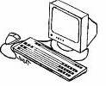
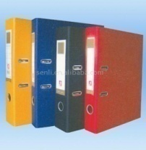

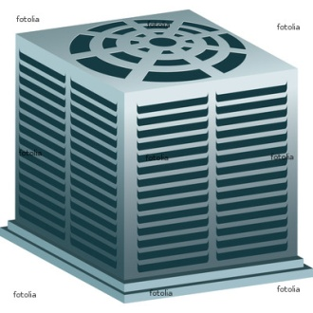
Proposed RFID Solution
Reader
Tagged Assets
Database
Reports
Private and Confidential

Slide 14
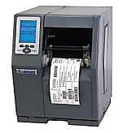
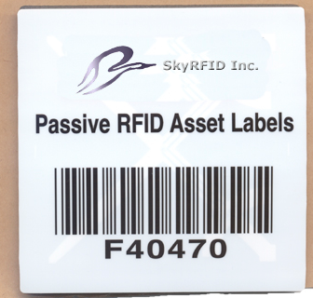
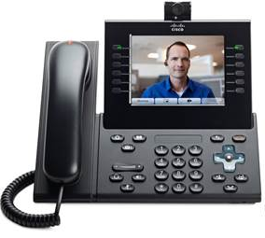

Proposed RFID Solution
Asset Registration Process
Tag Registration & Printing
Tag & Fixing Mechanism
Registered Tag Affixed On Asset
Private and Confidential

Slide 15
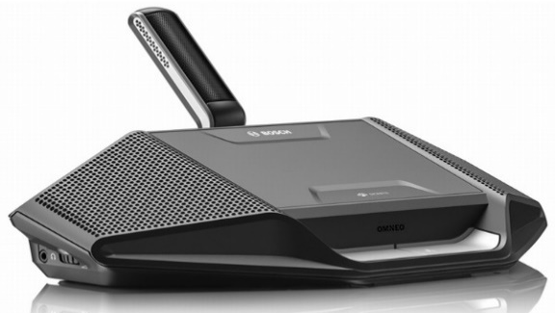
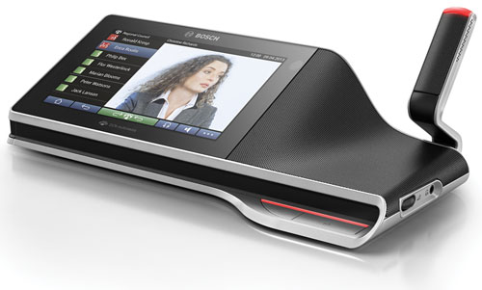
Proposed RFID Solution
Physical Audit/Verification of Asset
Private and Confidential

Slide 16
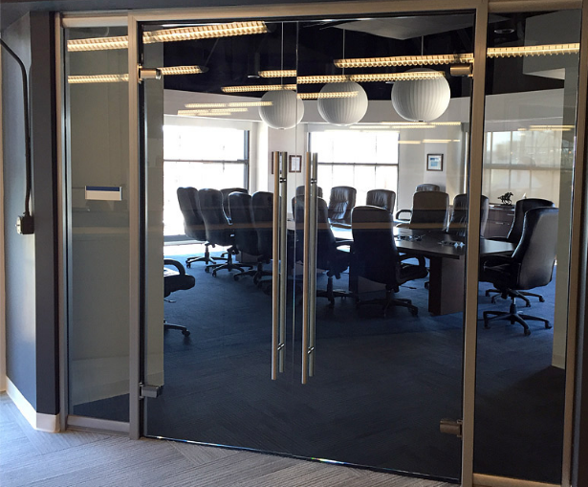


Proposed RFID Solution
Place of Antitheft Gate
Reader
LAN Cable
RF Cable
ANT-1
ANT-2
If user try to take out asset without permission
My-Asset System will record the log of appropriate
asset & Alert will going to be authorized person.
Theft gate
RFID Tagged Asset on Table
ANT-4
ANT-3
Private and Confidential

Slide 17
Benefits of RFID Solution
STA My-Asset System enables the following:
Monitoring and tracking Asset movement.
Better Asset visibility and Asset utilization.
Quick allocation of Assets and immediate update on their status.
Identification of the deviations from expected Asset location or condition.
Generation of trigger/exception based alerts or specific warning notifications.
Access to historical data for identification and elimination of operational bottlenecks.
Maintenance of Asset inventories and validation of the Asset utilization.
Private and Confidential

Slide 18
Benefits of RFID Solution
Benefits of STA My-Asset Tracking System
Fully automated: My-Asset is a paperless, fully digitized and flexible tracking and management solution which can work with multiple readers and databases. Total asset aging and history can be maintained and viewed at all times. Every asset can be linked to multiple users and vice-versa. Details of assets and assigned tags can be printed as labels using a label printer
Alerts and Alarms: Warranty, tracks and schedules maintenance and expiry dates are maintained and alerts and alarms are given to user accordingly. Alerts and alarms are also given when a user or asset enters to unpermitted area. Alerts are received on SMS and Email to ensure that the user reads and responds instantly.
Quick and advanced search and efficient report generation: User –friendly report generation rendered as graphs and charts, coupled with features to slice, dice and sort data and save in all formats (Microsoft excel as well) empowers the users of My-Asset to make swift and informed decisions.
Support Group of companies: My-Asset can be implemented to track assets across multiple (group of) companies thereby creating a unique asset management and tracking system at a group level.
Private and Confidential

Slide 19
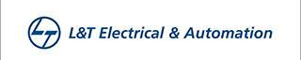






Valuable Asset Management Client
Private and Confidential

Slide 20
Thank You
In case of any queries, contact us at
sales@stallionindia.com
Ph: 7718879343
Private and Confidential

